Slide 2

µSAFABOT: A Robotics Learning Platform for a Hands-On Laboratory Approach to an Introductory ECE Course
Captain Steven M. Beyer
United States Air Force Academy
Electrical and Computer Engineering
Notes:
Hello, my name is Capt Steve Beyer and today I’d like to present the work that me and my colleague, Col Brian Neff accomplished creating a robotics learning platform used in an introductory ECE course at the United States Air Force Academy.

Slide 3
Motivation
Notes:
Before I present the robotics platform, I’d like to talk a bit about our motivation. Over the past ten years there has been a steady negative trend in the number of electrical and computer engineering (ECE) majors graduating from the United States Air Force Academy (USAFA). Additionally, our diversity numbers have been historically poor. On top of all of this, the United States Air Force has an increasing need for ECE majors with expertise in robotics, an area that has not been a focus in our program. After doing some research on evidence-based pedagogy and what has worked in the past at other universities I found that project based learning seemed to be the answer, especially in such a hands-on field such as ECE. Looking at our curriculum, however, I noted that the first course that students took in our ECE degree was a lecture-focused introductory ECE course. So the problem I needed to fix was how do I increase recruiting and diversity in our major, while at the same time helping to shift our ECE program towards robotics to meet the Air Force’s needs. My solution to this problem was to spark and promote a passion in ECE and robotics from day one in our program through a course that introduces fundamental ECE topics all while designing, implementing, and testing a robotics system. This course, very much like we saw in the previous presentation, is an introductory course with no expectation of prerequisites from the students.

Slide 4
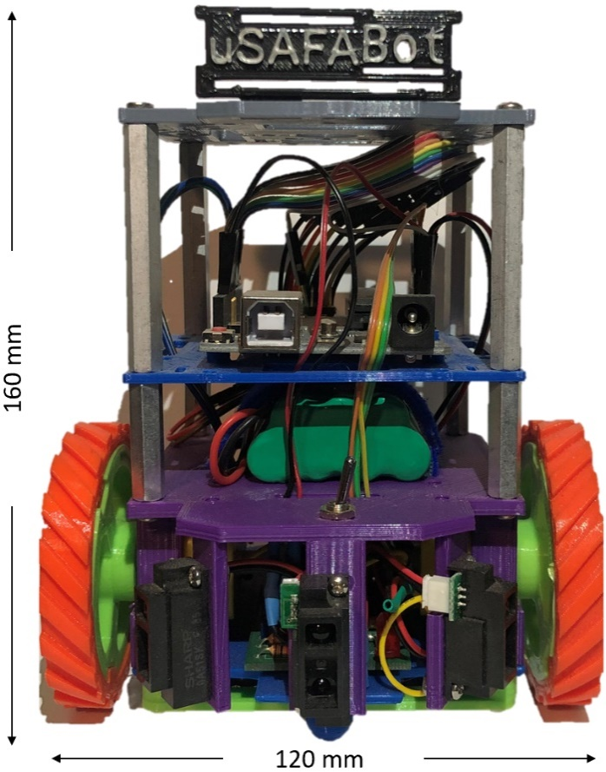
The Testbed: Physical Body
Notes:
There are many off-the-shelf robotics kits available commercially: Arduino Robot, Pololu 3pi Robot, SparkFun micro. However, from experience, many of these kits lose support over time, have difficult instructions, or have parts impossible to replace when a student inevitably breaks something. Building μSAFABOT from the ground up allows students to not only understand every interaction between each hardware and software component, but also allows instructors to easily replace parts or troubleshoot issues. The μSAFABOT system is less focused on fundamental understanding of each underlying system, but more on the integration, design, and motivation sides of student learning.
The body of the testbed includes customizable 3D printed tiers that enable the mounting of motors, sensors, and other components. The µSAFABOT testbed’s current configuration can carry an Arduino Uno, Raspberry Pi 4, two direct current (DC) motors, three Sharp infrared distance sensors, and a Pololu QTR-8RC Reflectance Sensor Array. Mounting holes and slots in the layers provide flexibility to mount components in a variety of orientations. The testbed is powered using a pack of seven rechargeable AAA batteries stored on one of the layers.

Slide 5
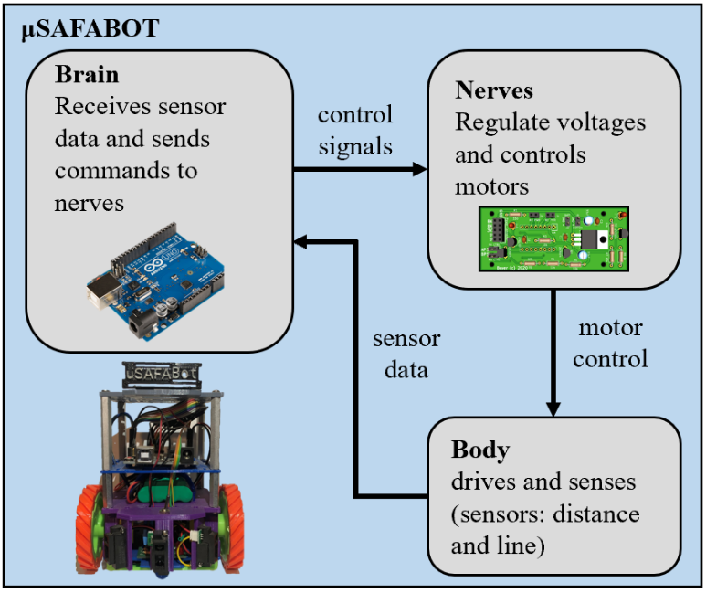
The Testbed: Software Architecture
Notes:
The software architecture is presented in Figure 2 and creates a control loop between the brain, nerves, and body. Starting at the brain, a controller process continuously polls the body for environment information from on-board sensors to inform the robot’s current state. The controller utilizes the current state information and sensor inputs to provide direction and PWM signals to the nerves. The nerves translate the control signal to drive the left and right motors accordingly, completing the loop.

Slide 6
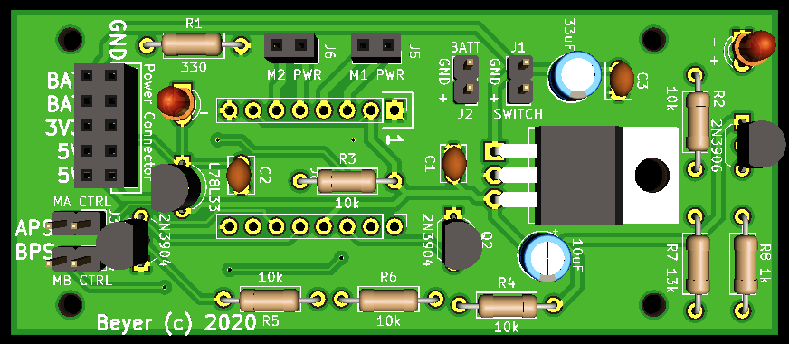
The Testbed: Printed Circuit Board
Notes:
The nerves consist of a custom printed circuit board (PCB) that provides voltage regulation and motor control. The PCB takes an input voltage between 7 V and 20 V and provides a fixed 3.3 V and 5 V output at a peak current of 250 mA and 1.5 A, respectively. An integrated motor driver chip converts direction and PWM signals from the Arduino Uno to power and control two DC motors.

Slide 7
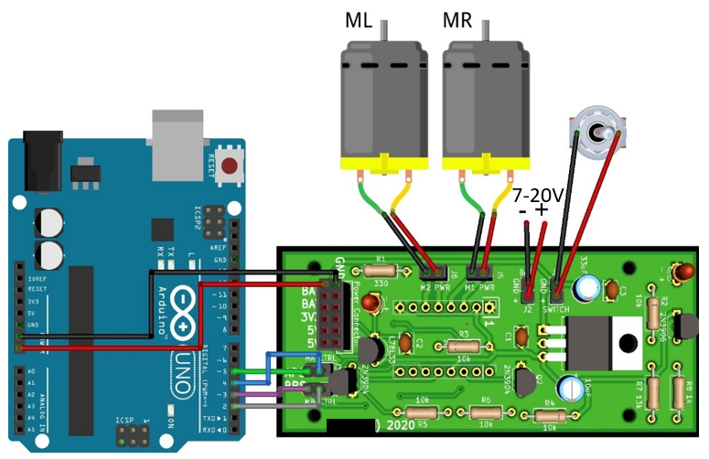
The Testbed: Wiring Diagram
Notes:
The nerves consist of a custom printed circuit board (PCB) that provides voltage regulation and motor control. The PCB takes an input voltage between 7 V and 20 V and provides a fixed 3.3 V and 5 V output at a peak current of 250 mA and 1.5 A, respectively. An integrated motor driver chip converts direction and PWM signals from the Arduino Uno to power and control two DC motors.

Slide 8
Syllabus
Block 1: Introductory Topics (10 lessons)
Block 2: Robotics Design and Implementation (20 lessons)
Block 3: Maze Competition (10 lessons)

Slide 9
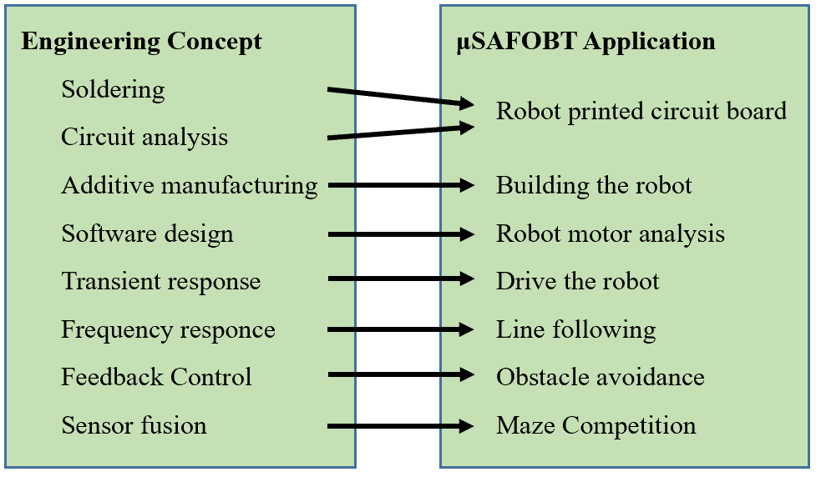
Laboratories
Notes:
7 Laboratories. while there are no grades assigned in this course, frequent checkpoints allow for no-stakes testing which has been proven to increase student performance, especially in minorities [13]. Instead of taking tests, students work at their own pace to meet deliverable deadlines that they set individually. For example, a student may decide to have their motor driver and power distribution boards soldered by lesson 21. This form of contract learning enables students to work at their own pace to gain understanding [14] and empowers them to take responsibility for their education [15].

Slide 10
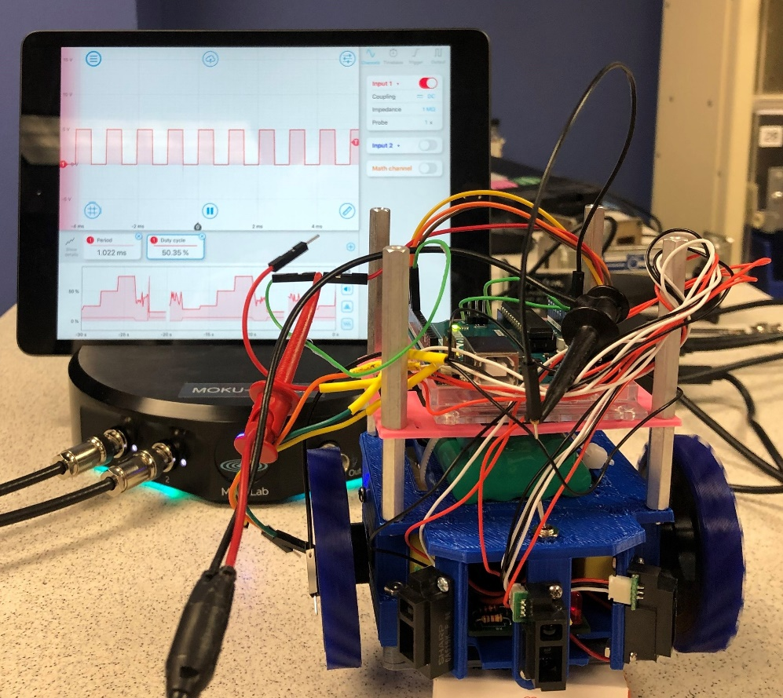
State of the Art Instrumentation
Liquid Instrument's Moku:Lab
Notes:
7 Laboratories

Slide 11
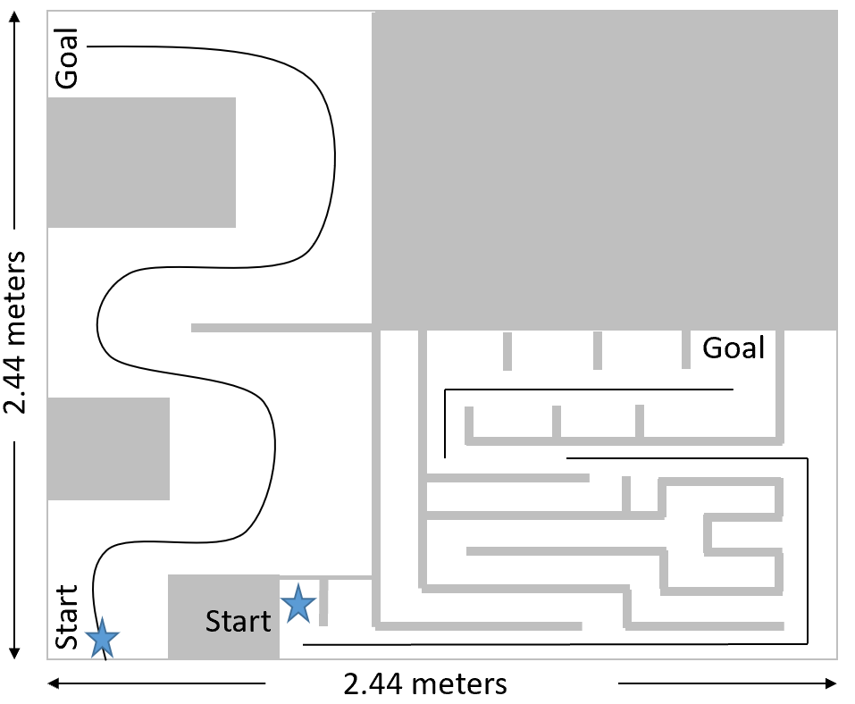
Final Project

Slide 12
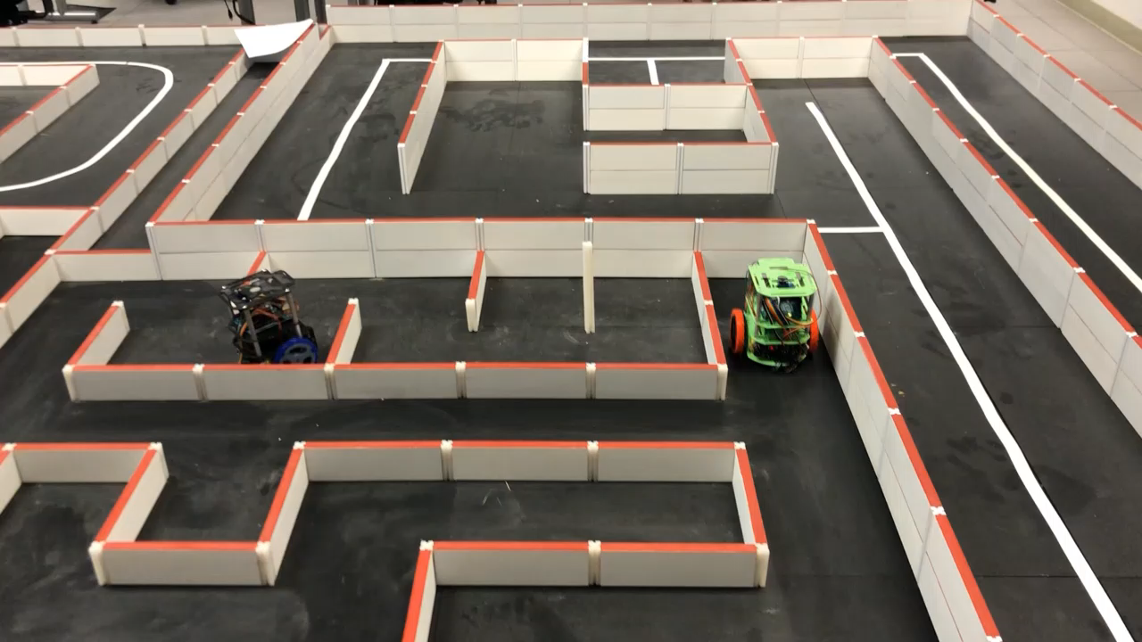
Final Project

Slide 13
Results (N=23 for original course; N=47 for redesigned course)
Notes:
Class of 22 Best recruiting class in 20 years, 60% diversity, 14 total females. Class of 23 was another top rated recruiting effort with half of the students are female. Additionally, since implementing the robotics focus, we have had 12 students start robotics research efforts with half of these students starting in their second year, which is their first semester after taking this course. Additionally, we created a robotics track within our ECE program and we guide students who do well in this course or have a passion for these topics into this track.

Slide 14
Anecdotal Results
“This course has probably been my favorite course I have ever taken, not just at USAFA, but also in all my education thus far.”
Another student who spent much more time than required working on μSAFABOT, said he did so “not because [he] had to, to earn a grade, but because [he] was engaged and passionate about the nature of the class and what [he] was learning.”
One student commented that the course “motivated [him] to pursue graduate school for robotics and become an instructor at USAFA through the graduate school program.”
Another student saw the hands-on format of the class and focus on μSAFABOT “lead [him] to take more in-depth robotics courses…and an internship with the NSA focusing on Artificial Intelligence and Machine Learning.”
Notes:
These are first or second year students who are already hoping to continue a career in robotics.

Slide 15

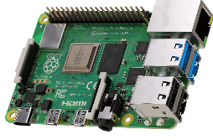

Future Work
https://github.com/AF-ROBOTICS/RoboticsLearningPlatform
Notes:
One more quick note: while not the easiest effort, during the pandemic

